Slide 1

CLUSTERING
COBWEB
The algorithm learns incrementally: it does not require that all instances be present before it begins learning
It also addresses the problem of determining the correct number of clusters
Example: Categorization of single cell animal
The features are: color, number of tails, and nuclei

Slide 2

CLUSTERING
1st Observation
Category C1 p(C1) = 1/1
Feature | Value | p(V|C1)
Tails | 1 | 1/1
Color | Light | 1/1
Nuclei | One | 1/1

Slide 3

Category C1 p(C1) = 2/2
Feature | Value | p(V|C1)
Tails | 1 | 1/2
 | 2 | 1/2
Color | Light | 2/2
Nuclei | One | 1/2
 | Two | 1/2
2nd Observation
Category C2 p(C2) = 1/2
Feature | Value | p(V|C2)
Tails | 1 | 1/1
 | 2 | 0/1
Color | Light | 1/1
Nuclei | One | 1/1
 | Two | 0/1
Category C3 p(C3) = 1/2
Feature | Value | p(V|C3)
Tails | 1 | 0/1
 | 2 | 1/1
Color | Light | 1/1
Nuclei | One | 0/1
 | Two | 1/1

Slide 4

Category C1 p(C1) = 3/3
Feature | Value | p(V|C1)
Tails | 1 | 1/3
 | 2 | 2/3
Color | Light | 2/3
 | Dark | 1/3
Nuclei | One | 1/3
 | Two | 2/3
1st possibility:
Place example in C2
Category C2 p(C2) = 2/3
Feature | Value | p(V|C2)
Tails | 1 | 1/2
 | 2 | 1/2
Color | Light | 1/2
 | Dark | 1/2
Nuclei | One | 1/2
Category C3 p(C3) = 1/3
Feature | Value | p(V|C3)
Tails | 1 | 0/1
 | 2 | 1/1
Color | Light | 1/1
 | Dark | 0/1
Nuclei | One | 0/1
Two
1/2
Two
1/1
4

Slide 5
Category C1 p(C1) = 3/3
Feature | Value | p(V|C1)
Tails | 1 | 1/3
 | 2 | 2/3
Color | Light | 2/3
 | Dark | 1/3
Nuclei | One | 1/3
 | Two | 2/3
2nd possibility:
Place example in C3
Category C2 p(C2) = 1/3
Feature | Value | p(V|C2)
Tails | 1 | 1/1
 | 2 | 0/1
Color | Light | 1/1
 | Dark | 0/1
Nuclei | One | 1/1
 | Two | 0/1
Category C3 p(C3) = 2/3
Feature | Value | p(V|C3)
Tails | 1 | 0/2
 | 2 | 2/2
Color | Light | 1/2
 | Dark | 1/2
Nuclei | One | 0/2
 | Two | 2/2
5

Slide 6
CLUSTERING
3rd possibility: Create a new category C4
C1
C2 C3 C4
We evaluate the correctness of all these three possibilities by a measure
and then allocate the example to the most suitable category

Slide 7
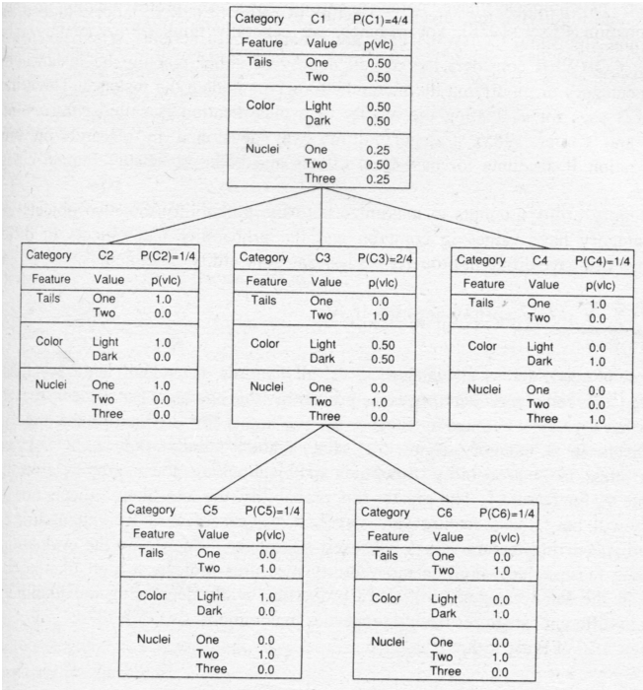
CLUSTERING

Slide 8
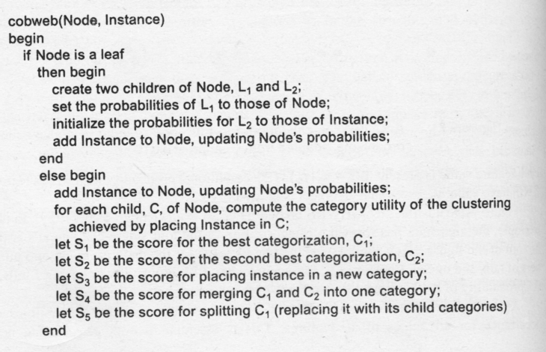
CLUSTERING
The COBWEB Algorithm

Slide 9
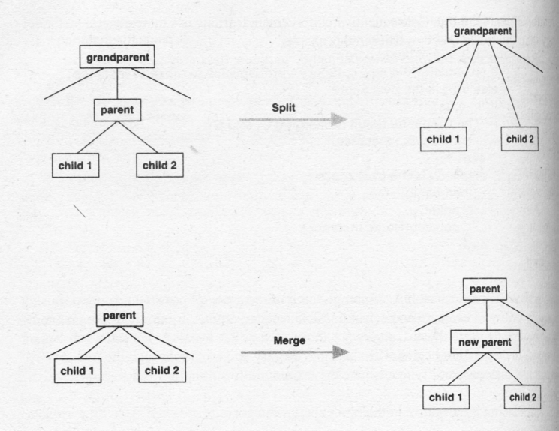
CLUSTERING

Slide 10
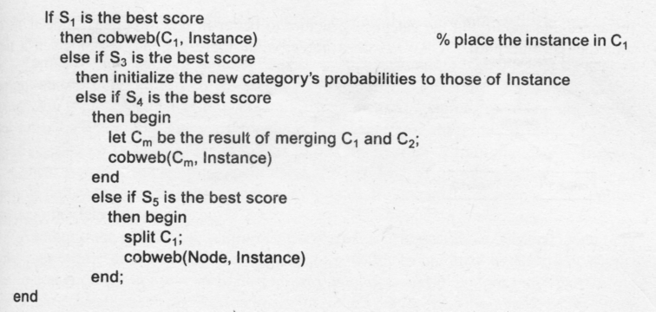
CLUSTERING
The COBWEB Algorithm

